Slide 1


SMART WATER BOTTLE
TEAM MEMBERS:
B.SOWMIYA-927622BEC196
S.SOWMIYAA-927622BEC199
S.THAVANIRUTHA-927622BEC236
S.VARSHINI-927622BEC241
GUIDED BY,
Dr.K.SHEIKDAVOOD
(ASISSTANT PROFESSOR/ECE)

Slide 2
INTRODUCTION :
Introducing a smart water bottle in a software project involves integrating sensors and connectivity features into a traditional water bottle to track water intake and provide personalized hydration reminders.
The software aspect includes developing a mobile app or web interface to display hydration data, set goals, and send notifications. Additionally, it might involve implementing algorithms to analyze user data and offer insights for improved hydration habits

Slide 3
PROBLEM STATEMENT :
Due to busy schedules of humans and endless distractions, it’s hard to remember to drink enough water by the humans. So, in order to build a healthy water drinking habit, it’s important to track our water intake every day .
To serve this purpose the Smart Interactive Water Bottle will be of great help. This Smart Interactive Water Bottle helps the user to track his daily amount of water consumed, average amount of water consumed, last water intake time and also alert the user reminding him to drink water.

Slide 4
OBJECTIVES :
The primary objective of the Smart Water Bottle project is to leverage technological advancements to enhance and revolutionize the way individuals approach hydration.
The project aims to create a sophisticated notification system, providing users with a holistic and personalized experience that goes beyond traditional water level indicators.
Smart water bottle is an innovative hydration device equipped with technology to track and enhance your water intake. It often includes features like hydration reminders, tracking apps, and sometimes even integration with fitness devices to monitor your hydration levels during workouts.

Slide 5
EXISTING SYSTEM :
In the existing system, traditional water bottles are used without any smart features or technology integration.
Users rely on manual methods, such as mental tracking or occasional reminders, to ensure adequate hydration throughout the day.
There is no automated system in place to monitor water intake, provide personalized recommendations, or track hydration trends over time.
Overall, the existing system lacks the advanced features and benefits offered by a smart water bottle solution, such as automated tracking, personalized reminders, data insights, and integration with mobile apps or web interfaces.

Slide 6
PROPOSED SYSTEM :
Develop a water bottle equipped to track water intake, measure the level of hydration.
The hardware should also include connectivity features such as Bluetooth or Wi-Fi to sync data .
By using using website we have to improve and send message to the user .
To improve user engagement with the smart water bottle through a website, consider implementing features with the user's device.

Slide 7
Personalized Dashboard:
Create a user-friendly dashboard where users can easily view their hydration history, set goals, and track their progress over time.
Customizable Reminders:
Allow users to customize their hydration reminders based on their schedule and preferences. This could include push notifications or email reminders.

Slide 8
COMPARISON :
A normal water bottle serves the basic purpose of holding water, offering no additional functionality. Conversely, a smart water bottle incorporates advanced features such as hydration tracking, reminders, and customization options.
It monitors water intake levels, reminding users to drink at regular intervals, thereby preventing dehydration.
Unlike its traditional counterpart, a smart water bottle provides data insights into hydration habits, allowing users to analyze their intake patterns and adjust accordingly. Additionally, it often integrates with health and fitness apps/devices, offering a holistic approach to wellness management.

Slide 9
SOCIAL RELEVANCE:
Health Awareness
Environmental Impact
Data Collection for Research
Community Engagement
Accessibility

Slide 10
PLAN OF WORK COMPLETION:
Design and Prototyping:
Develop software prototypes, focusing on usability and functionality.
Testing and Feedback:
Conduct rigorous testing, gather feedback, and iterate on design and functionality.
Development:
Build the smart water bottle's components, including reminder algorithms, and user interface.

Slide 11
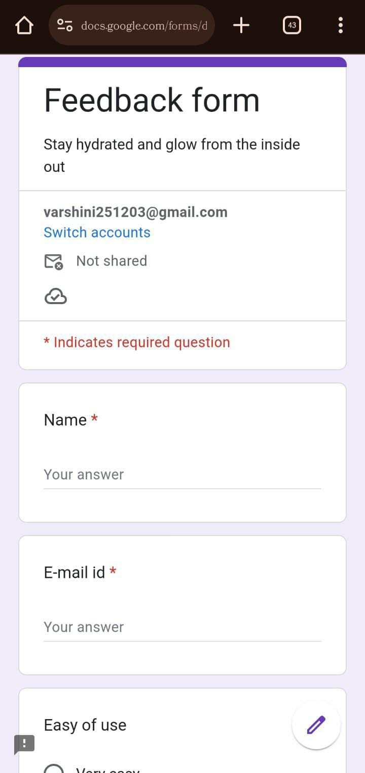
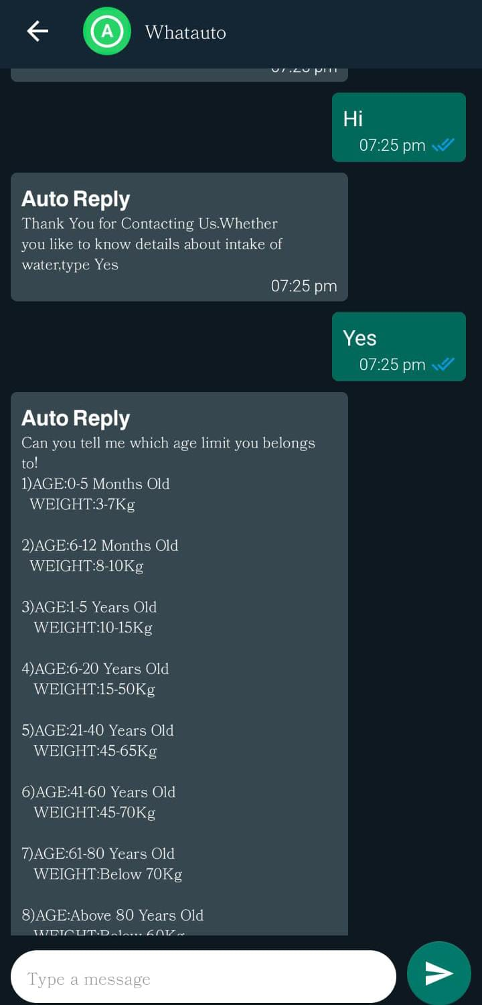
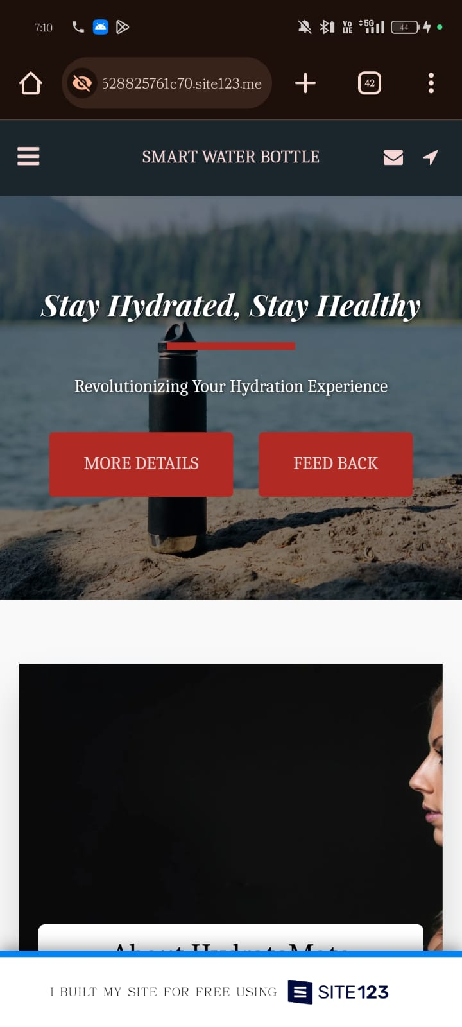

Slide 12
CONCLUSION :
With customizable reminders and intelligent tracking capabilities, staying hydrated becomes second nature, regardless of your busy schedule.This innovative solution ensures that dehydration becomes a thing of the past, allowing you to enjoy sustained energy levels and enhanced productivity throughout the day. Its sleek design and user-friendly interface make it a seamless addition to any lifestyle.With this essential tool by your side, you can confidently take on each day, knowing that you're giving your body the hydration it needs to thrive. Unlock your full potential and embrace a healthier,

Slide 13
REFERERENCES :
A. Al-Fuqaha, M. Guizani, M. Mohammadi, M. Aledhari, and M. Ayyash, "Internet
of Things: A Survey on Enabling Technologies, Protocols, and Applications," IEEE
Commun. Surv. Tutor., vol. 17, no. 4, pp. 2347-2376, Fourthquarter 2015.
C. Perera, A. Zaslavsky, P. Christen, and D. Georgakopoulos, "Context Aware
Computing for The Internet of Things: A Survey," IEEE Commun. Surv. Tutor., vol.
16, no. 1, pp. 414-454, First 2014.
E. Jovanov, "Preliminary analysis of the use of smartwatches for longitudinal health
monitoring," in 2015 37th Annual International Conference of the IEEE Engineering
in Medicine and Biology Society (EMBC), 2015, pp. 865-868.
"Smartwatch Group." [Online]. Available: http://www.smartwatchgroup.com/.
"Quantified Self - Self Knowledge Through Numbers," Quantified Self. [Online].
Available: http://quantifiedself.com/.

